Slide 1
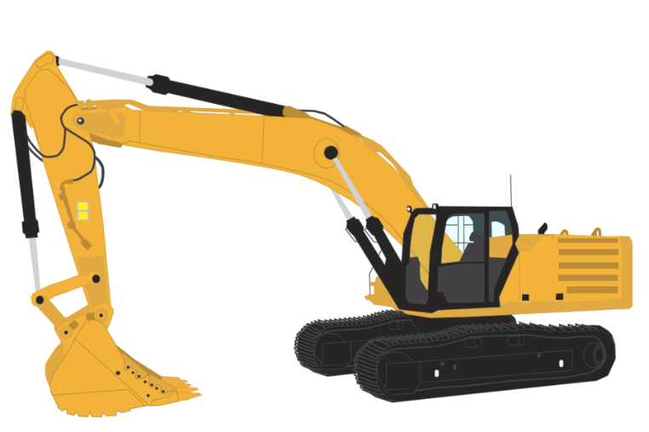
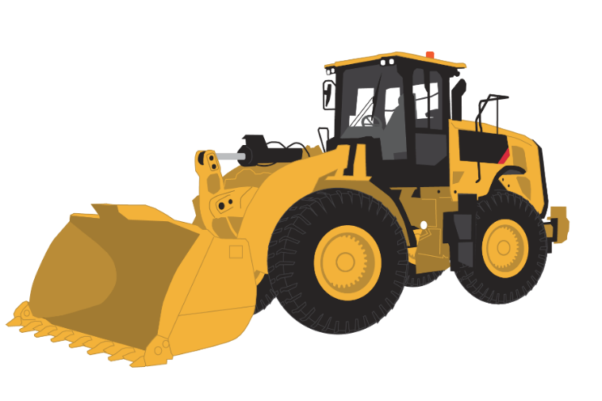
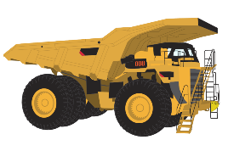
Project 3
Machine learning injury predictor
By Grant Towers and Nicholas Mcmahon

Slide 2

Contents
Project Intent and Purpose
Technical Summary
Data Preparation
Database/Hosting
Data Migration and ETL
Initial Visualisations
Machine Learning
app.py and app.js Functions
HTML Pages
Presentation
Observations, Limitations and Potential Enhancements to Model

Slide 3
Project Intent and Purpose
We wanted to develop a data model to predict incident outcomes, using 2020 US Mining Data.
After testing a number of models, we decided on the 'Sex', 'Age', 'Occupation' and 'Operational Process' columns as our model data.
The website will require the end user to select values for their future, incoming role, then the site will predict: 1. The 'Activity' the person will most likely be injured doing. 2. The 'Body Part Injured' of the person that will be injured. 3. The 'Nature of Injury' that will be incurred. 4. The 'Source of Injury' that will cause the injury. These will all be shown to the visitor as fields on the Website.

Slide 4


Technical Summary – Database/Hosting
Created the AWS RDS Server to house the Postgres DB.
Create the S3 Bucket to store the incident file.
Upload the incident data file to the existing data into the S3 bucket.
Create a Heroku Instance and connect to GitHub Repo.
Deploy the Heroku Website.

Slide 5
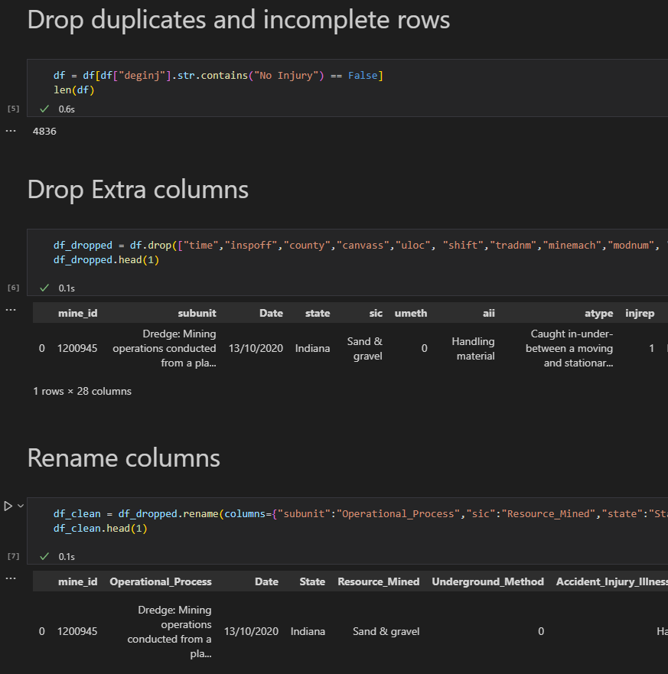
Technical Summary – Data Preparation
Extracted raw incident data from US CDC Website.
Uploaded the data file to AWS S3 Bucket.
Import file using Jupiter, complete significant data clean-up and grouping as required:
We dropped unnecessary columns and non-injury data
A lot of the column data was coded/abbreviated, so we had to interpret, then rename the data columns
We had to group values together in many cases (to reduce the number of options), such as operational process, age, injured body parts, occupations
Working File: Import Data to Postgres

Slide 6
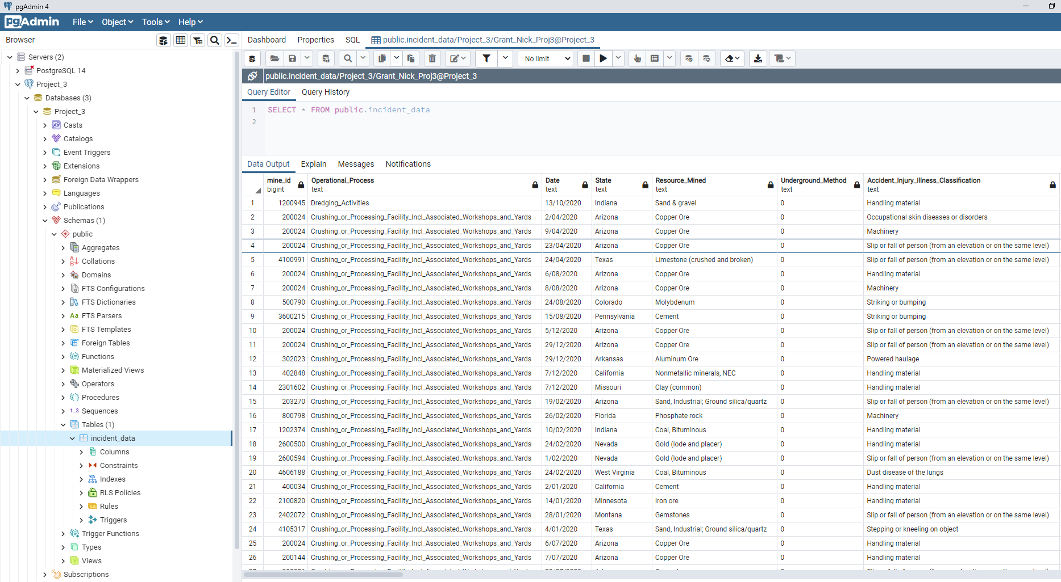
Technical Summary – Data Migration and ETL
Following the data clean-up, migrate the revised data frame to Postgres.
Data now ready for query.
Working File: N/A

Slide 7
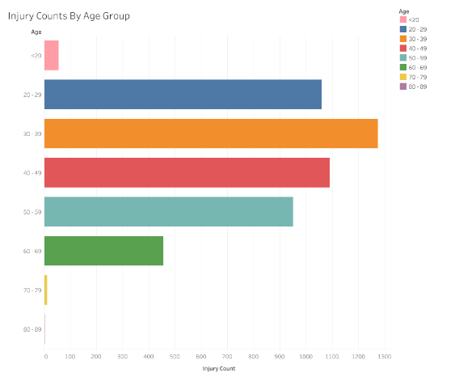
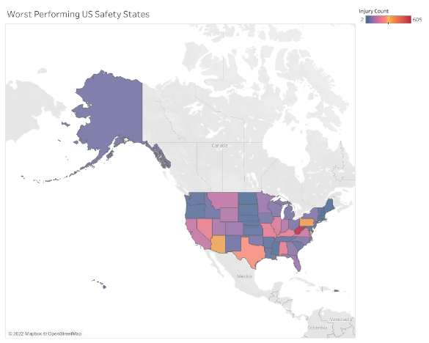
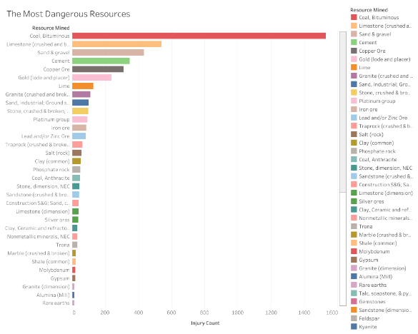
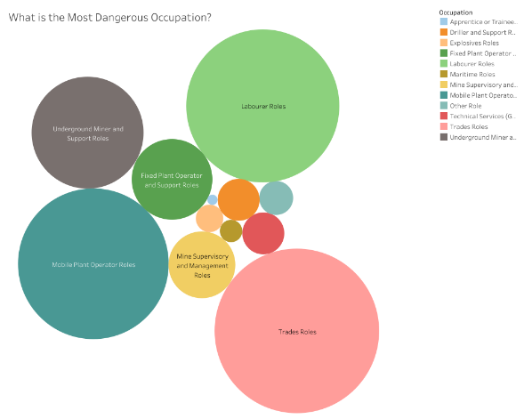
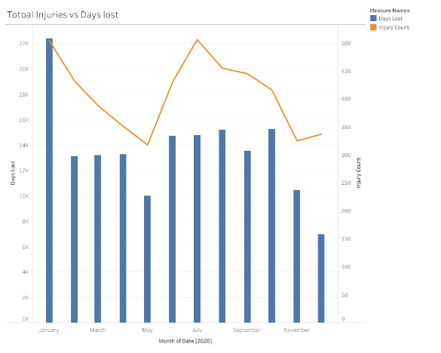
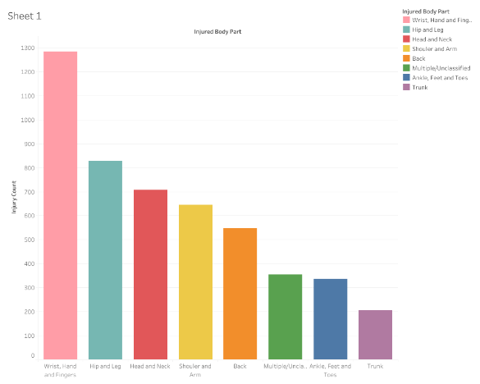
Technical Summary – Initial Visualisations
Connect an export of the 'clean' incident data to Tableau Public:
We created miscellaneous images showing key analysis points we looked at from the data.
As this was not a major element of our project, we wanted to identify some key points, but are not interpreting the results.
Working File: N/A

Slide 8
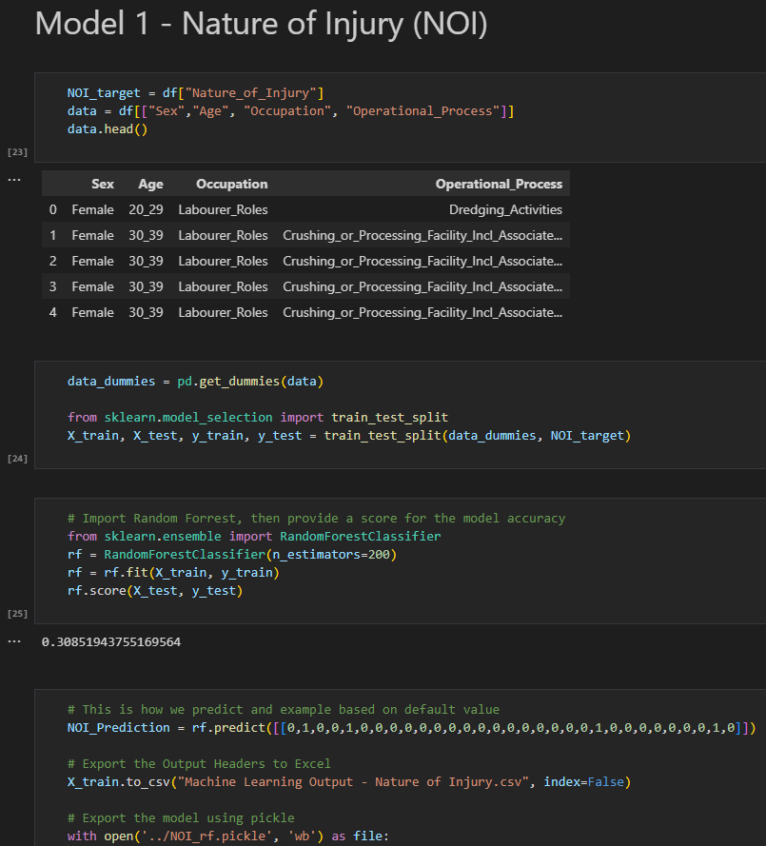
Technical Summary – Machine Learning
We created a 4 predictive models using “Random Forests”, requesting a person enter some basic details:
'Sex' (Female/Male)
'Age' (Grouped by Decades)
'Occupation' (Grouped Data into General Occupation Types that we determined)
'Operational Process" (Grouped Data for the Workplace that we determined)
The model will then use the incident details to predict the outcome of the following fields:
'Nature of Injury' - Overall Model Accuracy: 30.0% (Possible Outcomes: 31 options)
'Injured Body Part' - Overall Model Accuracy: 24.9% (Possible Outcomes: 8 options)
'Source of Injury' - Overall Model Accuracy: 13.9% (Possible Outcomes: 107 options)
'Activity' - Overall Model Accuracy: 22.2% (Possible Outcomes: 82 options)
We had to store the models in a “Pickle” file, which allowed us to store (in a file) then import the model in a separate file (such as app.py)…
Working File: Machine Learning - Data Model

Slide 9
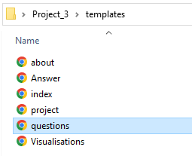
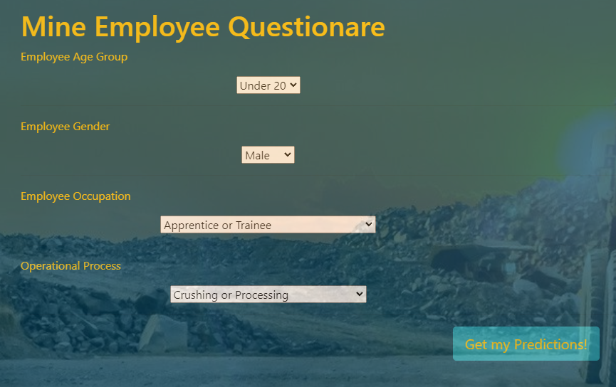
Technical Summary – app.py and app.js Files
'app.py' renders all of the website templates, which are all straight forward HTML – until we get to the 'questions.html' page.
'app.js' creates all of the drop down boxes and values, then once the user selects their data.
Clicks the ‘Get my Predictions’ button:
Working File: app.py and app.js

Slide 10
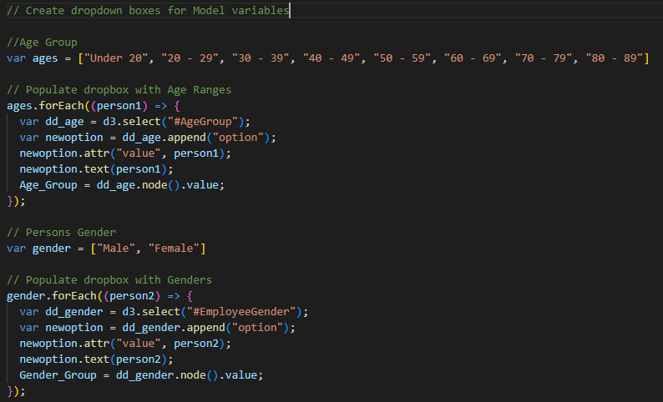
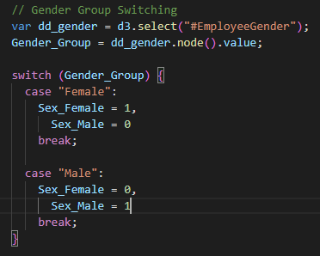
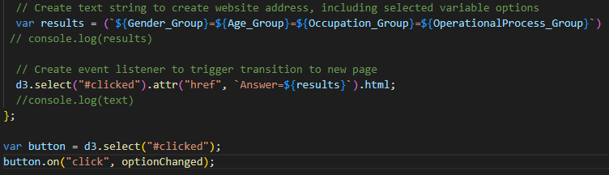
Technical Summary – app.py and app.js Files
Within the 'app.js’ file, there are mapped out options for all possible values, so that the app stores the binary code for each option (based on the selection) and collates it.
During this process, the submitted information is and appended to memory using ‘.node’. These values are concatenated and now align with our data model.
A concatenated text string is created and used to navigate to the 'Answer.html' page.
Working File: app.js
https://grantnickproj3.herokuapp.com/Answer=Male=Under%2020=Apprentice%20or%20Trainee=Crushing%20or%20Processing

Slide 11
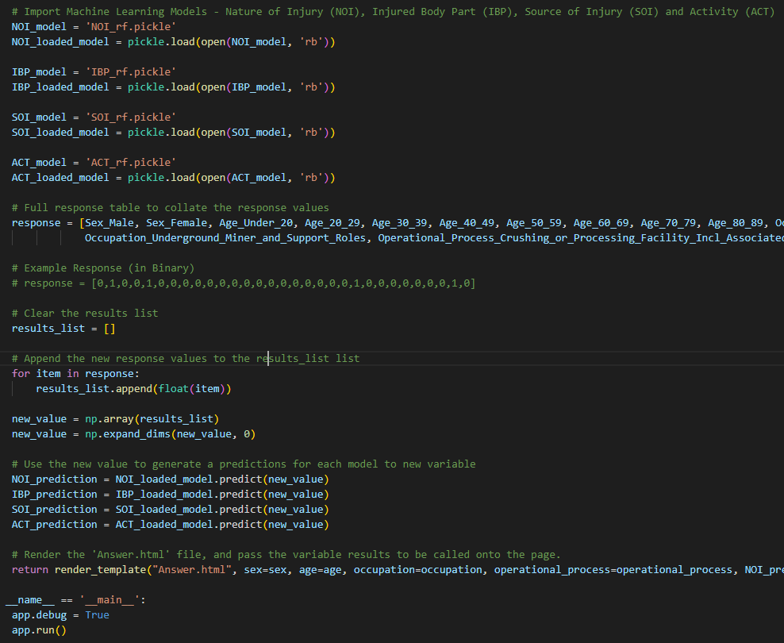
Technical Summary – app.py and app.js Files
We now have a single text string (which aligns with the structure of our data model) - for example:
'rf.predict([[0,1,0,0,1,0,0,0,0,0,0,0,0,0,0,0,0,0,0,0,0,1,0,0,0,0,0,0,0,1,0]])’.
Within ‘app.py’, we import the ‘Pickle’ files (containing the trained data model), and using the model, call it to predict a value for our user submitted values against our models.
We store the results in the “Response” variable, to present them during the render_template process, which allows us to call them and present them in 'Answer.html', which we can all see.
Working File: app.js

Slide 12
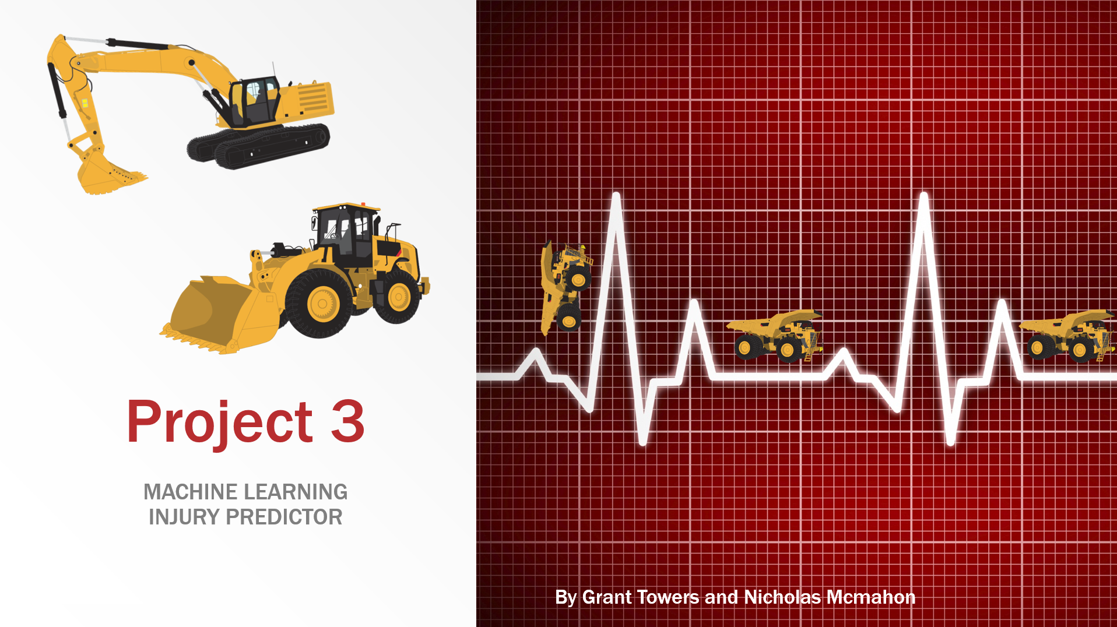
Technical Summary – Presentation
Created this presentation.
Stored it in Project Repo and also linked directly in S3 bucket (for direct download).
Working File: Project 3.pptx

Slide 13

Observations, Limitations and Potential Enhancements to Model
Observation:
What we set out to achieve (creating a predictive model
based upon selected criteria) has been successful.
Limitations:
However, we both learned a critical limitation to the model - that any person referring to this model needs to understand.
The model uses previously recorded incident data to make a prediction and although we have a large amount of data, the more filters, or additional parameters you add to the model, the smaller the dataset is to make a prediction.
For example (right), persons aged 70+ have a very small pool of incidents, so the model’s potential to be correct would be lower (as there is less data to predict from)
In this case, it is a better idea to group the 50 – 89’s together (as this would likely not impact the outcome.
The Key Learning – know your data, then you are able to mould your data to suit the model and get the best possible results.
Age Group | Number Incidents | % of Total
Less Than 20 | 56 | 1.1%
20 - 29 | 1,061 | 21.6%
30 - 39 | 1,275 | 26.0%
40 - 49 | 1,091 | 22.2%
50 - 59 | 951 | 19.4%
60 - 69 | 457 | 9.3%
70 - 79 | 13 | 0.3%
80 - 89 | 4 | 0.1%
Total Incidents | 4,908

Slide 14
Observations, Limitations and Potential Enhancements to Model
Potential Enhancements:
There were a number of areas that we feel could improve the model:
As per point on previous slide, consider focusing on better groupings - consolidate or exclude outlier data.
Add more models and/or amend the criteria for selection. We wanted it to be a logical assessment for a new employee, but there are better variations we could have used, which may result in more accurate predictions.
More model refinement - group more of the options for the 'Source of Injury' and 'Activity' fields - as a smaller number of options would likely improve the accuracy of the model.
Collate More Data - As this model is reliant on data, some of the more obscure occupations/operations end up with less options, therefore the accuracy of the model is reduced.
Age Group | Number Incidents | % of Total
Less Than 20 | 56 | 1.1%
20 - 29 | 1,061 | 21.6%
30 - 39 | 1,275 | 26.0%
40 - 49 | 1,091 | 22.2%
50 - 59 | 951 | 19.4%
60 - 69 | 457 | 9.3%
70 - 79 | 13 | 0.3%
80 - 89 | 4 | 0.1%
Total Incidents | 4,908

Slide 15
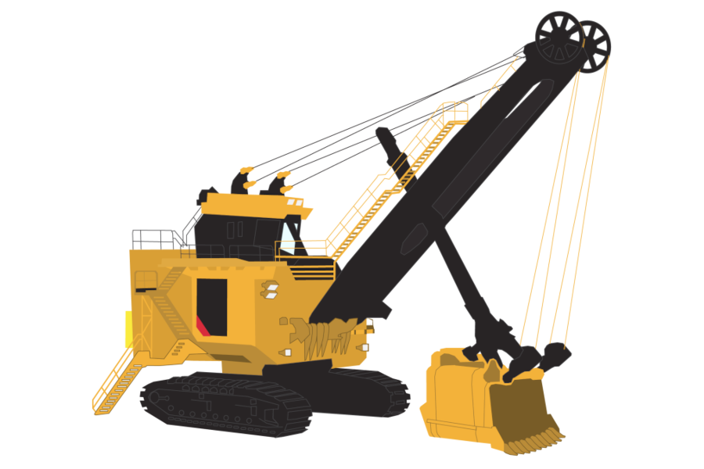

Thankyou for listening… Any Questions?
Stay safe out there!

